Slide 1
C♯ Dependency Injection Testing Entity Framework
Rasmus Lystrøm
Associate Professor
ITU
rnie@itu.dk

Slide 2
Agenda
Testing …
Dependency Injection
Testing Entity Framework

Slide 3
Testing …
Testing live databases is hard
Testing live full systems is hard
By transitivity: Testing … is hard…

Slide 4
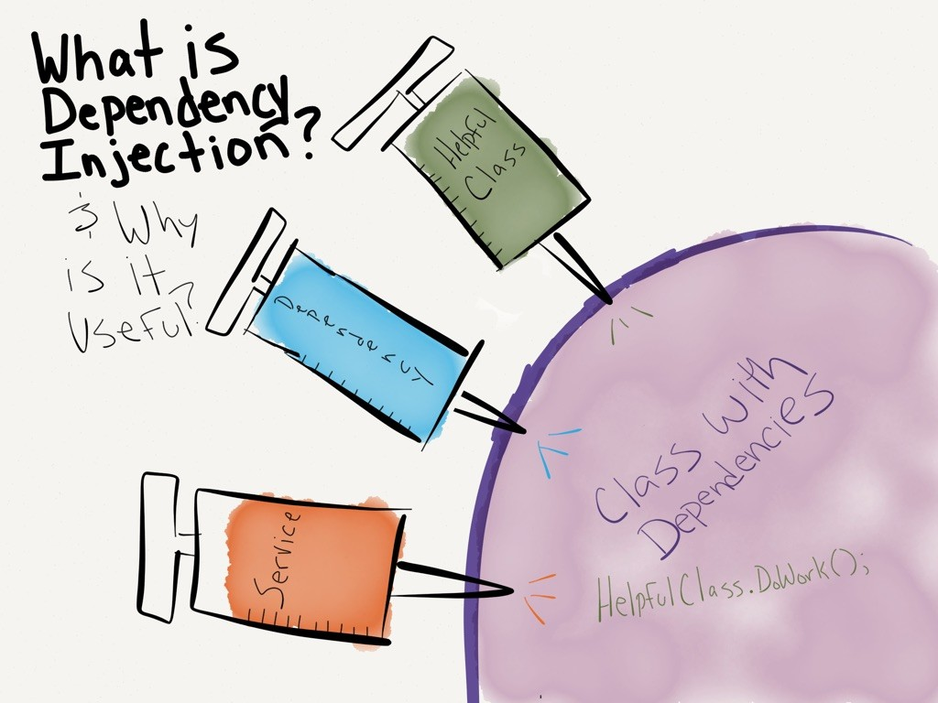
http://dwiardiirawan.com/index.php/2016/05/18/what-is-dependency-injection-and-what-are-the-advantage/

Slide 5
Dependency Injection
Software design pattern which implements Inversion of Control (IoC)

Slide 6
Dependency Injection (DI)
Constructor Injection
Property (Setter) Injection
Interface Injection

Slide 7
Dependency Injection
Structured readable code
Testable code
Dependency Inversion Principle
Separation of Concerns
Rock SOLID!!!
AWESOME!!
Pun intended

Slide 8
Programming to interface, not implementation…
public interface IFooService
{
bool Update(Foo foo);
}
public class FooService : IFooService
{
bool Update(Foo foo)
{
// Implementation
}
}

Slide 9

Using IFooService
public class Worker
{
public bool DoWork(FooDto dto)
{
IFooMapper mapper = new FooMapper();
var foo = mapper.Map(dto);
IFooService service = new FooService();
return service.Update(foo);
}
}

Slide 10
Constructor Injection (preferred)
public class Worker
{
private readonly IFooService _service;
public Worker(IFooService service)
{
_service = service;
}
public bool DoWork(FooDto fooDto)
{
// Implementation
}
}
Private readonly field
Initialize from constructor

Slide 11
Property Injection
Public setter
public class Worker
{
public IFooService Service { private get; set; }
public void DoWork(Foo foo)
{
Service?.Update(foo);
}
}
Is this King?

Slide 12
Interface Injection
public interface IServiceSetter<T>
{
void SetService(T service);
}
public interface IServiceSetter<T>
{
T Service { set; }
}

Slide 13
Interface Injection II
Interface
public class Worker : IServiceSetter<IFooService>
{
private IFooService _service;
public void SetService(IFooService service)
{
_service = service;
}
public void DoWork(FooDto fooDto)
{
// Implementation
}
}
Implement interface

Slide 14
Interface Injection III
Interface
public class Worker : IServiceSetter<IFooService>
{
public IFooService Service { private get; set; }
public bool DoWork(FooDto fooDto)
{
// Implementation
}
}
Implement interface

Slide 15
Best practices
Use Adapter to enable interface if needed
Use constructor injection
Program to interface
Use an IoC container
More on this in a couple of weeks...

Slide 16
IoC Container
dotnet add package Microsoft.Extensions.DependencyInjection
IServiceCollection services = new ServiceCollection();
services.AddScoped<IService, Service>();
var provider = services.BuildServiceProvider();
var service = provider.GetRequiredService<IService>();

Slide 17
Unit Testing

Slide 18
Unit Testing Best Practices
Never test against a live database, file, or web service
01
Single Responsibility Principle
02
Only test the ”System Under Test”
03
Atomic tests
04
Use either mocks or stubs
05

Slide 19
Stubs
public class FooServiceFalseStub : IFooService
{
public bool Update(Foo foo)
{
return false;
}
}

Slide 20
Stubs
[Fact]
public void DoWork_when_IFooService_Update_false_returns_false()
{
IFooService service = new FooServiceFalseStub();
using var worker = new Worker(service);
var result = worker.DoWork(new FooDto());
Assert.False(result);
}

Slide 21
Mocks
[Fact]
public void DoWork_when_IFooService_Update_false_returns_false()
{
var mock = new Mock<IFooService>();
IFooService service = mock.Object;
using (var worker = new Worker(service))
{
var result = worker.DoWork(new FooDto());
Assert.False(result);
}
}

Slide 22
Mocks
[Fact]
public void DoWork_when_IFooService_Update_true_returns_true()
{
var mock = new Mock<IFooService>();
mock.Setup(m => m.Update(It.IsAny<Foo>())).Returns(true);
using (var worker = new Worker(mock.Object))
{
var result = worker.DoWork(new FooDto());
Assert.True(result);
}
}

Slide 23
Demo

Slide 24
Testing Entity Framework

Slide 25
SQLite in-memory database
dotnet add package Microsoft.EntityFrameworkCore.Sqlite
using var connection = new SqliteConnection("Filename=:memory:");
connection.Open();
var builder = new DbContextOptionsBuilder<MyContext>().UseSqlite(connection);
using var context = new MyContext(builder.Options);

Slide 26
Best practices
Wrap in logical units/service classes/repositories
Don’t test built-in code…
Program to interface

Slide 27
Demo

